Slide 1
15-213 Recitation 5: Attack Lab
26 Sept 2016

Slide 2
Agenda
Reminders
Stacks
Attack Lab Activities

Slide 3
Reminders
Bomb lab is due tomorrow!
“But if you wait until the last minute, it only takes a minute!” - NOT!
Don't waste your grace days on this assignment
Attack lab will be released tomorrow!

Slide 4
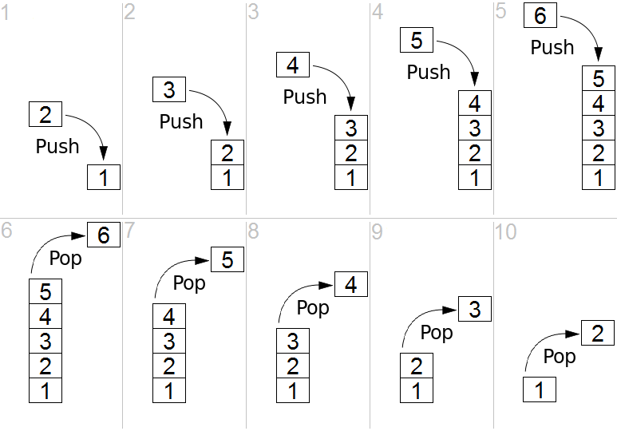
Stacks
Last-In, First-Out
just like a stack of plates
pushes and pops to preserve registers must be in opposite order
x86 stack grows down
lowest address is “top”
Image credit: Wikimedia Commons

Slide 5
Stack
Stack space is allocated in “frames”
Represents the state of a single function invocation
Used primarily for two things:
Storing callee save registers
Storing the return address of a function
Can also store:
Local variables that don’t fit in registers
Function arguments 7+

Slide 6
x86-64/Linux Stack Frame
Carnegie Mellon
Current Stack Frame (“Top” to Bottom)
“Argument build:” Parameters for function about to call
Local variables If can’t keep in registers
Saved register context
Old frame pointer (optional)
Caller Stack Frame
Return address
Pushed by call instruction
Arguments for this call
Caller
Frame
Arguments
7+
Frame pointer %rbp
Return Addr
Old %rbp
(Optional)
Saved
Registers
+
Local
Variables
Argument
Build
(Optional)
Stack pointer
%rsp

Slide 7
Stack Maintenance
Functions free their frame before returning
Return instruction looks for the return address at the top of the stack
What if the return address has been changed?

Slide 8
Attack Lab Activities
Three activities
Each relies on a specially crafted assembly sequence to purposefully overwrite the stack
Activity 1 – Overwrites the return addresses
Activity 2 – Writes an assembly sequence onto the stack
Activity 3 – Uses byte sequences in libc as the instructions

Slide 9
Form pairs
One student needs a laptop
Login to a shark machine
$ wget http://www.cs.cmu.edu/~213/activities/rec5.tar
$ tar xf rec5.tar
$ cd rec5
$ make
$ gdb act1

Slide 10
Activity 1
(gdb) break clobber
(gdb) run
(gdb) x $rsp
(gdb) backtrace
Q. Does the value at the top of the stack match any frame?
(gdb) x /2gx $rdi // Here are the two key values
(gdb) stepi // Keep doing this until
(gdb)
clobber () at support.s:16
16 ret
(gdb) x $rsp
Q. Has the return address changed?
(gdb) fin
Should exit normally, May segfault

Slide 11
Activity 1 Post
In this activity, we overwrote part of the stack
Placing two return addresses onto the stack
Return to printHi()
Return to main
Call clobber()
Clobber executes
In printHi()
In main()
ret
ret
0x7fffffffe338
0x000000400553
0x000000400560
0x000000400500
0x000000400560

Slide 12
Activity 2
$gdb act2
(gdb) break clobber
(gdb) run
(gdb) x $rsp
Q. What is the address of the stack and the return address?
(gdb) x /4gx $rdi
Q. What will the new return address be? (i.e., what is the first value?)
(gdb) x/5i $rdi + 8 // Display as instructions
Q. Why rdi + 8?
Q. What are the three addresses?
(gdb) break puts
(gdb) break exit
Q. Do these addresses look familiar?

Slide 13
Activity 2 Post
Normally programs cannot execute instructions on the stack
Main used mprotect to change the memory protection for this activity
Clobber wrote a return address of the stack to the stack
And a sequence of instructions
Three addresses: “Hi\n”, puts(), exit()
Why callq *%rsi?
As the attacklab writeup notes, calling functions is hard.
Return oriented programming is much easier.

Slide 14
Activity 3
$gdb act3
(gdb) break clobber
(gdb) run
(gdb) x /5gx $rdi
Q. Which value will be first on the stack?
Q. At the end of clobber, where will it return?
(gdb) x /2i <return address>
Q. What does this sequence do?
Q. Do the same for the other addresses. Note that some are return addresses and some are for data. When you continue, what will the code now do?

Slide 15
How was it constructed?
Think of possible executions
What are the bytes of the instructions?
Write short assembly into foo.s
gcc -c foo.s
objdump -d foo.o
OR: Convert them to byte sequences (Attacklab write-up has a table)
Also important so you can switch between register names
After determining the desired instruction(s)
Use the Linux tool xxd to dump the raw bytes to a file
Or: Objdump -d rtarget (or act3 or …)
Search the file

Slide 16
If You Get Stuck
Please read the writeup. Please read the writeup. Please read the writeup. Please read the writeup!
CS:APP Chapter 3
View lecture notes and course FAQ at http://www.cs.cmu.edu/~213
Office hours Sunday through Thursday 5:00-9:00pm in WeH 5207
Post a private question on Piazza
man gdb, gdb's help command

Slide 17

Remember...

Slide 18
Appendix

Slide 19
Attack Lab Tools
gcc -c file.s
convert the assembly code in file.s to object code in file.o
objdump -d file.o
disassemble the code in file.o; shows the actual bytes for the instructions
./hex2raw
convert hex codes into raw ASCII strings to pass to targets
gdb
determine stack addresses
paper and pencil
for drawing stack diagrams

Slide 20
More Useful GDB Commands
x/[n]i <address>
b <loc> if <cond>
cond <bp> <cond>
commands <bp>
tbreak <loc>
finish
layout asm
layout reg
disassemble n instructions at <address>
conditional breakpoint, stop only if <cond> true
add condition to existing breakpoint <bp>
execute commands when breakpoint <bp> hit
set temporary breakpoint – auto-deletes when hit!
run until current frame (function) returns, and print return value
split the screen into separate disassembly and command windows
show register window as well (after layout asm)

